Slide 1
COIT12207 Internet Applications
Week 3 Introduction to Bootstrap

Slide 2
Outline
What is Bootstrap
Why is it so popular
Why do we need a framework
Get started with Bootstrap
Structure of a Bootstrap project
Create a webpage with Bootstrap styles
Overwrite Bootstrap styles

Slide 3
What is Bootstrap?
“Bootstrap is the most popular HTML, CSS, and JavaScript framework for developing responsive, mobile first projects on the web.” http://getbootstrap.com/
Bootstrap, originally named Twitter Blueprint, was developed by a small group of developers at Twitter as an internal framework to encourage consistency.
Became an open source project and become a popular framework.
Bootstrap 5 released on 5 May 2021

Slide 4
Why is it so popular?
Responsiveness
Content of a webpage adjusts dynamically, based on different window size and devices
https://handbook.cqu.edu.au/
Compatibility
Compatible with the latest versions of the Google Chrome, Firefox, Internet Explorer, Opera, and Safari browsers
Simplicity
Simple and easy to use
Do not require much CSS knowledge

Slide 5
Why do we need a framework?
What is a framework?
A set of predefined, reusable classes, libraries or programs.
What can frameworks do?
Demo - Plain HTML
Notes:
https://en.wikipedia.org/wiki/Software_framework

Slide 6
Why do we need a framework? (cont.)
Enable developers to focus on business processes by predefining things that are not business related
Instead of reinventing the wheels, we take advantage of other people’s work
Helps standardisation and consistency
Similar look and feel across systems of one organisation
Saves time, resource and money
Frameworks often make things simpler
Easy to learn, easy to train
Reduces the length of software development cycle

Slide 7
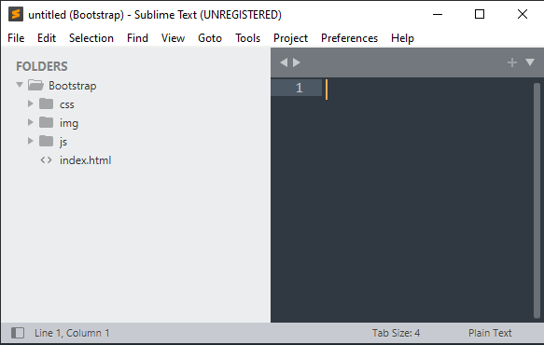
Structure of a Bootstrap project
This week you will learn to set up a Bootstrap Project. Let’s examine the folder structure
Dev folder: a place for you to store all your development projects
Bootstrap folder: this is your Bootstrap project
css and js: these two folders contain core Bootstrap framework code. We should not touch any file downloaded from Bootstrap. But we can add in our files later into these folders.
img folder: a place to store our images
Our HTML files stay in Bootstrap folder

Slide 8
Hands-on Projects
Hands-on Project 1
Set up a Bootstrap web project
Hands-on Project 2
Create a webpage with Bootstrap styles
Hands-on Project 3
Overwrite Bootstrap styles

